Slide 1
Config Scanner
JFlex group project
A JFlex scanner that reads key = value configuration files and reports every token
with its line and column.
Group 10: Name ID
YAN CHANTHOL e20231348
LY Sengkim e20231094
Compilation I4 GIC · Academic year 2026-2027
Notes:
TO FILL IN: your name and student ID. Check that G01 is your group ID (taken from the zip name Lab01_G01). Solo project, so list only yourself.

Slide 2
Input format and project scope
Input example (N02_section_string.conf)
Expected output: line:column TYPE lexeme
# server settings
[server]
host = "localhost"
port = 8080
2:1 LBRACKET [
2:2 IDENTIFIER server
2:8 RBRACKET ]
3:1 IDENTIFIER host
3:6 ASSIGN =
3:8 STRING "localhost"
… # end: tokens=9 errors=0
Supported forms
Outside the scope
Lines of key = value, [section] headers, # comments. Values: identifier, true/false, integer, decimal, "string". ASCII names, UTF-8 file.
Arrays, nested sections like [a.b], negative numbers, string escapes, non-ASCII identifiers, and checking statement structure.
Notes:
Input and output come from tests/inputs and tests/expected in your zip. Highlight the lines the scanner reads if you like. Comments and blanks produce no token, which is why output starts at 2:1.

Slide 3
Token definitions and competing rules
Token type | Pattern or macro | Example
IDENTIFIER | [a-zA-Z_][a-zA-Z_0-9]* | max_users
BOOLEAN | "true" | "false" | true
INTEGER | [0-9]+ | 8080
DECIMAL | [0-9]+ "." [0-9]+ | 2.5
STRING | "\"" [^"\r\n]* "\"" | "localhost"
ASSIGN | = | =
LBRACKET / RBRACKET | [ and ] | [server]
ERROR_* | unexpected char, open string, 1. | @ "abc 1.
1 · Keyword vs identifier
true → BOOLEAN: ties with IDENTIFIER at 4 characters, first rule wins. trueish → IDENTIFIER: 7 characters beat 4.
2 · Integer vs decimal
2.5 → DECIMAL: 3 characters beat INTEGER with 1. 1. → malformed number (2 beat 1).
Notes:
Tests B02 and B03 cover both competing-rule cases. JFlex picks the longest match and, on a tie, the earliest rule.

Slide 4
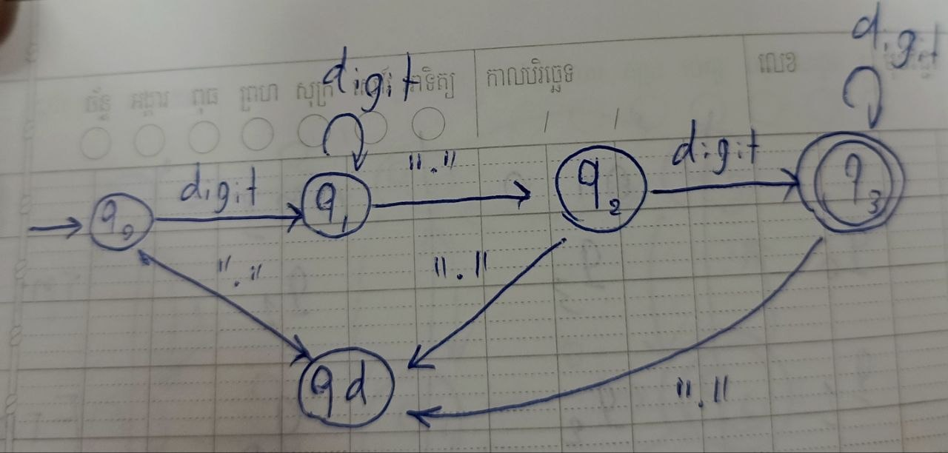
Scanner design and one token automaton
Input .conf file
→
Generated ConfigScanner.java
→
Tokens and errors
DFA for DECIMAL (start q0, final q3) over {digit, .}
Link to JFlex
Rule {DECIMAL} = {DIGIT}+ "." {DIGIT}+ returns DECIMAL.
Accepted: 2.5 ends in q3.
Rejected: 1. stops in q2, so {BAD_NUMBER} reports an error.
Notes:
The DFA is from your REPORT.md, section 4. You may redraw it in your own style. Explain the accepted and rejected example aloud.

Slide 5
Test evidence and one corrected bug
Your test results
One bug and its correction
6 normal inputs · 6 PASS
Input that exposed it: R01_bom.conf: port = 80, saved with BOM. It did not fail.
5 boundary cases · 5 PASS
Expected vs actual before the fix: Expected 1:1 IDENTIFIER port. Actual
4 invalid inputs · 4 PASS
1:1 IDENTIFIER port. Same, so PASS.
Changed rule and output after: No change needed. Output stays 1:1 IDENTIFIER port.
Notes:
TO FILL IN: actual pass counts (run run_tests.sh) and ONE real bug your tests exposed. Your zip leaves the bug section blank on purpose. Do not invent one.

Slide 6
Live demonstration
1 · Generate and compile
2 · Normal input
java -jar lib/jflex-full-1.9.1.jar -d generated src/config.jflex
javac -d out generated/*.java src/*.java
java -cp out Main demo/demo_normal.conf
Expect 9 tokens, 0 errors.
3 · Competing rules
4 · Invalid input
demo/demo_competing.conf: true / trueish and 2 / 2.5
demo/demo_invalid.conf: error at 1:8, then scanning continues on line 2.
Notes:
NOTE: the lib folder in your zip is empty. Download jflex-full-1.9.1.jar from jflex.de into lib/ before the demo and test the commands once.

Slide 7
Results and team contributions
What works
Who contributed what
Eight token types and three error kinds with exact line and column, and scanning that continues after errors.
YAN CHANTHOL: all tasks, from rules and driver to tests and slides.
Conclusion
Our JFlex scanner correctly splits configuration files into tokens with line and column positions. It uses the longest match, and the first rule on a tie. It reports errors with their positions and keeps scanning. It passed all our tests, but it checks only token patterns and does not check whether the lines make sense.
Notes:
TO FILL IN: your own lesson learned, your contribution list if different, and a one-sentence conclusion once real test results are in.

